Slide 1




HackOrbit 2025
Quanter

Slide 2

THEME & PROBLEM STATEMENT
Retail traders and aspiring investors often struggle with complex, expensive tools that lack personalized insights for evaluating trading strategies. This leads to guesswork instead of data-driven decisions.
There's a clear need for an intelligent, user-friendly platform that compares trading/investment strategies, delivers real-time analytics, and uses AI to support smarter trading choices.

Slide 3
PROPOSED SOLUTION
A web-based multi-strategy trading platform built with Flask and Python that enables real-time strategy testing and performance analysis.
Supports 10+ technical indicators (e.g., VWAP, RSI, MACD) to generate trades, compare and optimize trading strategies with visual analytics.
Calculates key performance metrics like Sharpe Ratio, CAGR, Win Rate, and Maximum Drawdown etc to evaluate strategy effectiveness.
Integrates a chatbot powered by OpenAI to explain strategy, offer insights, and assist users in making informed decisions.
Enables users to simulate trades, track portfolios, and receive automated strategy reports via email.
Designed to be accessible for both beginners and advanced users, bridging the gap between complexity and usability in fintech tools.

Slide 4
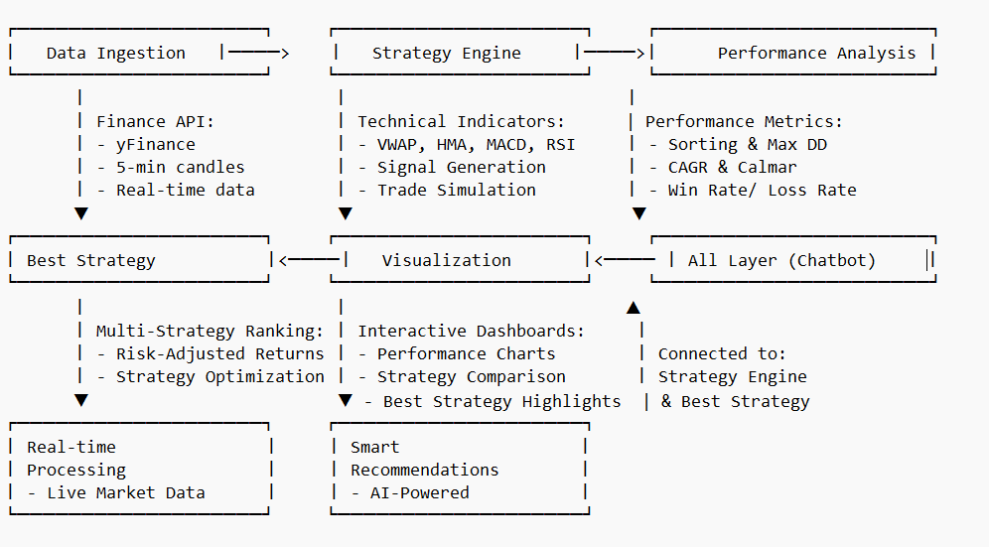
FLOWCHART / DIAGRAM

Slide 5
FLOWCHART / DIAGRAM
Data Ingestion
Fetches real-time market data via Finance API (yFinance) and Analyses 5-minute candles for accuracy.
Strategy Engine
Applies technical indicators (VWAP, HMA, MACD, RSI etc) , Generates signals and Simulates trades.
Performance Analysis
Evaluates strategies using Sharpe ratio, win rate, CAGR and Compares portfolio performance.
Best Strategy
Ranks strategies by risk-adjusted returns and Optimizes for maximum efficiency.
Visualization
Interactive dashboards display performance charts and comparisons.
AI Chatbot Layer
Provides real-time insights and recommendations for a selected strategy.
Real-Time & AI
Delivers live analysis and AI-driven strategy suggestions.

Slide 6
FEATURES AND NOVELTY
Features
My platform is a web-based trading system that supports over 10 technical indicators, including VWAP, RSI, and MACD, ADX etc.
It analyses real-time 5-minute tick data to simulate trades, perform back-testing, and generate key performance metrics such as Sharpe Ratio, CAGR, and Maximum Drawdown.
An integrated AI-powered chatbot offers strategy insights, email option to receive performance report.
All features are seamlessly presented through a clean and interactive Flask-based dashboard.
Novelty
What sets this platform apart is its combination of real-time analytics, strategy comparison, and conversational AI — all in one unified tool.
The OpenAI chatbot transforms complex financial metrics into accessible insights, bridging the gap for novice traders.
Uniquely, the platform also identifies and recommends the best-performing strategy for a selected stock, based on historical data and calculated performance metrics.
Designed for both practical trading and educational use, the platform offers a rare blend of usability, intelligence, and extensibility in the fintech space.

Slide 7
DRAWBACK AND SHOWSTOPPERS
Drawbacks:
Currently, the platform does not support live trading due to the absence of integration with brokerage APIs, restricting it to use in simulated environments.
The use of machine learning for strategy selection is limited and can be further expanded to enable predictive analysis.
This platform relies on the paid version of OpenAI for chatbot integration.
Not aligned with compliance and local regulatory requirements.
Showstoppers:
A major showstopper is the reliance on third-party data sources like Yahoo Finance, which may face rate limits or downtime.
Any API changes or data unavailability can disrupt strategy execution.

Slide 8
Quanter
Srisant Panigrahi ( Team Leader ) , (+91) 9692699586

Slide 9
Thank You

